Slide 1
Neural Networks
Jurafsky and Martin Chapter 7

Slide 2
Neural Networks
The building block of a neural network is a single computational unit. A unit takes a set of real valued numbers as input, performs some computation.

Slide 3
Neural Networks: A brain-inspired metaphor

Slide 4
A single neuron
Notes:
As the name suggests, neural networks were inspired by the brain’s computation mechanism, which consists of computation units called neurons. While the connections between artificial neural networks and the brain are in fact rather slim, we repeat the metaphor here for complete- ness. In the metaphor, a neuron is a computational unit that has scalar inputs and outputs. Each input has an associated weight. e neuron multiplies each input by its weight, and then sums1 them, applies a nonlinear function to the result, and passes it to its output. Figure 4.1 shows such a neuron.

Slide 5
Neural networks
Notes:
The neurons are connected to each other, forming a network: the output of a neuron may feed into the inputs of one or more neurons. Such networks were shown to be very capable computational devices. If the weights are set correctly, a neural network with enough neurons and a nonlinear activation function can approximate a very wide range of mathematical functions (we will be more precise about this later).
A typical feed-forward neural network may be drawn as shown. Each circle is a neuron, with incoming arrows being the neuron’s inputs and outgoing arrows being the neuron’s outputs. Each arrow carries a weight, reflecting its importance (not shown). Neurons are arranged in layers, reflecting the flow of information. The bottom layer has no incoming arrows, and is
the input to the network. the top-most layer has no outgoing arrows, and is the output of the network. The other layers are considered “hidden.” thee sigmoid shape inside the neurons in the middle layers represent a nonlinear function (i.e., the logistic function) that is applied to the neuron’s value before passing it to the output. In the figure, each neuron is connected to all of the neurons in the next layer—this is called a fully connected layer or an affine layer.

Slide 6
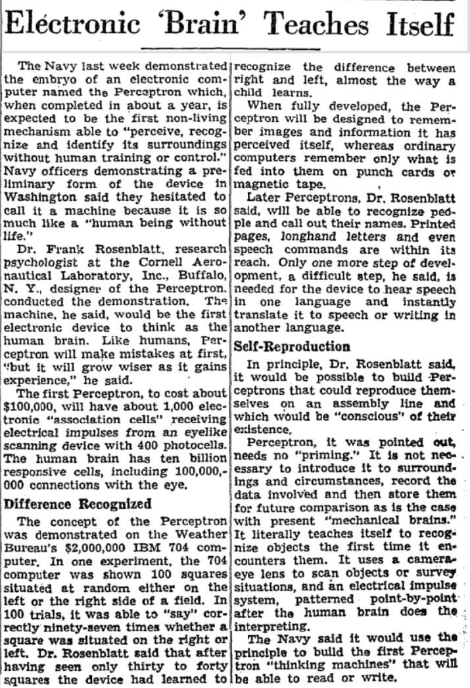
Review: Perceptron
Perceptrons were developed in the 1950s and 1960s loosely inspired by the neuron.
Notes:
New York Times - July 13, 1958 “Electronic 'Brain' Teaches Itself”
The Navy last week demonstrated the embryo of an electronic computer named the Perceptron which, when completed in about a year, is expected to be the first non-living mechanism able to "perceive, recognize and identify its surroundings without human training or control."

Slide 7
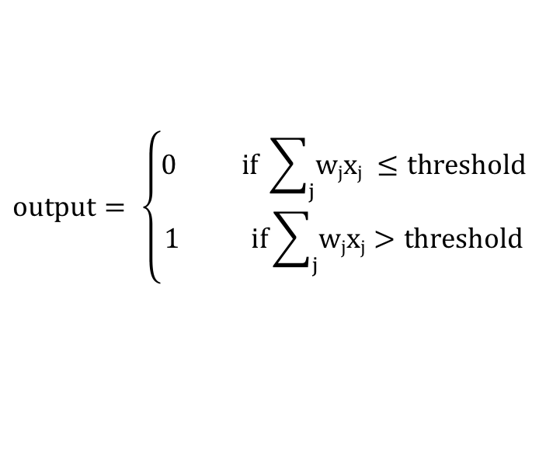
Review: Perceptron
Perceptron has inputs, x₁,x₂, .. x_{N}, and weights w₁,w₂, .. w_{N}
The perceptron outputs 0 or 1, based on the weighted sum is less than or greater than a threshold value
$$output= \left\{\begin{aligned}0 if \sum_{j}{wjxj} ≤threshold \\ 1 if\sum_{j}{wjxj}>threshold\end{aligned}\right.$$

Slide 8
Perceptrons for decision making
We can think about the perceptron or the sigmoid neuron as a device that makes decisions by weighing up evidence.
Example: Suppose there’s a cheese festival in your town. You like cheese.
Example from Michael Nielsen’s book Neural Networks and Deep Learning

Slide 9
Perceptrons for decision making
You might use 3 factors to decide whether to go.
Is the weather good?
Can your loyal companion come with you?
Is the festival near public transit?
These can be the binary input values to a perceptron

Slide 10
Perceptrons for decision making
By varying weights and the threshold we get different models of decision making
Example 1: w₁= 6 w₂ = 2 w₃ = 2, threshold = 5
Example 2: w₁= 6 w₂ = 2 w₃ = 2, threshold = 3
Notes:
Example 1: You adore cheese so much you’re happy to go without your loyal companion, even if it’s hard to get to, but you hate bad weather
Example 2: Lower the threshold to 3. Then the perceptron would decide that you should go to the festival whenever the weather was good or when both the festival was near public transit and your boyfriend or girlfriend was willing to join you.
Obviously, the perceptron isn't a complete model of human decision-making! But what the example illustrates is how a perceptron can weigh up different kinds of evidence in order to make decisions

Slide 11
Perceptrons for decision making
A complex network of perceptrons could make quite subtle decisions:
Layer 3
Complex decisions can be made by the perceptron in the third layer
Layer 1
Layer 2
1st layer makes 3 simple decisions by weighing the input evidence
2nd layer makes a decision by weighing up the results from the 1st layer of decision-making
Notes:
In this network, the first column of perceptrons - what we'll call the first layer of perceptrons - is making three very simple decisions, by weighing the input evidence. What about the perceptrons in the second layer? Each of those perceptrons is making a decision by weighing up the results from the first layer of decision-making. In this way a perceptron in the second layer can make a decision at a more complex and more abstract level than perceptrons in the first layer. And even more complex decisions can be made by the perceptron in the third layer. In this way, a many-layer network of perceptrons can engage in sophisticated decision making.

Slide 12
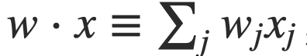
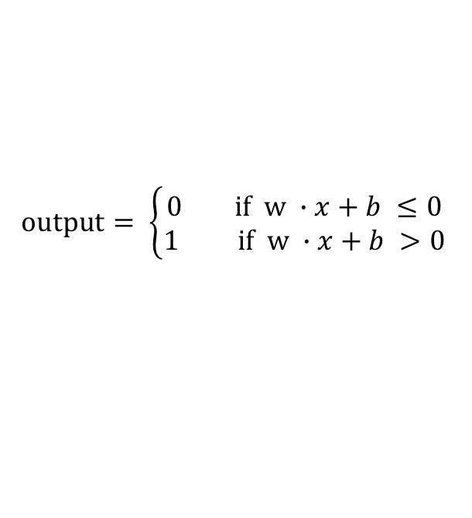
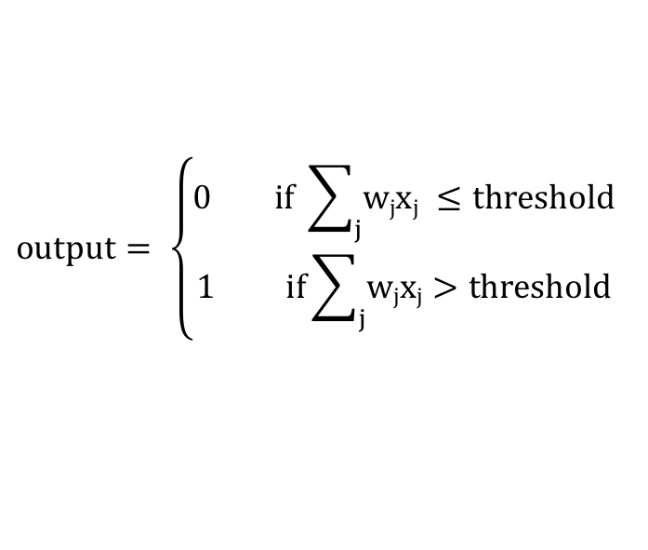
Weights, bias and dot products
Two notational changes simplify the way that perceptrons are described.
The first change is to replace the weighted sum as a dot product
The second change is to move the threshold to the other side of the inequality, and to replace it by a bias, b≡−threshold
$$output= \left\{\begin{aligned}0 if \sum_{j}{wjxj} ≤threshold \\ 1 if\sum_{j}{wjxj}>threshold\end{aligned}\right.$$
$$output= \left\{\begin{aligned}0 if w ∙x+b ≤0 \\ 1 if w ∙x+b >0\end{aligned}\right.$$
Notes:
You can think of the bias as a measure of how easy it is to get the perceptron to output a 1. Or to put it in more biological terms, the bias is a measure of how easy it is to get the perceptron to fire. For a perceptron with a really big bias, it's extremely easy for the perceptron to output a 1. But if the bias is very negative, then it's difficult for the perceptron to output a 1.

Slide 13
Activation Functions
Instead of directly outputting z = w·x+b, which is a linear function of x, neuron units apply a non-linear function f to z.
The output of this function is called the activation value for the unit, represented by the variable a. The output of a neural network is called y, so if the activation of a node is the final output of a network then
y=a= f(z)
There are 3 commonly used non-linear functions used for f: The sigmoid function The tanh function The rectified linear unit ReLU
The sigmoid function

Slide 14
Activation Functions
The sigmoid function
tanh
ReLU
Notes:
These activation functions have different properties that make them useful for differ- ent language applications or network architectures. For example the rectifier func- tion has nice properties that result from it being very close to linear. In the sigmoid or tanh functions, very high values of z result in values of y that are saturated, i.e., extremely close to 1, which causes problems for learning. Rectifiers don’t have this problem, since the output of values close to 1 also approaches 1 in a nice gentle linear way. By contrast, the tanh function has the nice properties of being smoothly differentiable and mapping outlier values toward the mean.
In practice, the sigmoid is not commonly used as an activation function.

Slide 15
Decision making OR logical functions
Perceptrons can be used to compute logical functions like AND, OR and NAND
Example:
Notes:
he weights w and bias b for perceptrons for computing logical functions. The inputs are shown as x1 and x2 and the bias as a special node with value +1 which is multiplied with the bias weight b. (a) logical AND, showing weights w1 = 1 and w2 = 1 and bias weight b = −1. (b) logical OR, showing weights w1 = 1 and w2 = 1 and bias weight b = 0. These weights/biases are just one from an infinite number of possible sets of weights and biases that would implement the functions.

Slide 16
Logical functions
Networks of perceptrons to compute any logical function
We can build any computation up out of NAND gates.
For example, a circuit which adds two bits x₁ and x₂
All unlabeled weights are -2, all biases =3.
Notes:
we can use networks of perceptrons to compute any logical function at all. The reason is that the NAND gate is universal for computation, that is, we can build any computation up out of NAND gates.
The NAND example shows that we can use perceptrons to compute simple logical functions. In fact, we can use networks of perceptrons to compute any logical function at all. The reason is that the NAND gate is universal for computation, that is, we can build any computation up out of NAND gates. For example, we can use NAND gates to build a circuit which adds two bits, x1 and x2. This requires computing the bitwise sum, x1⊕x2x1⊕x2, as well as a carry bit which is set to 1 when both x1 and x2 are 1, i.e., the carry bit is just the bitwise product x1x2:

Slide 17
The XOR problem
A single neural unit cannot be used to compute the XOR function
AND
OR
XOR
x1 | x2 | y
0 | 0 | 0
0 | 1 | 0
1 | 0 | 0
1 | 1 | 1
x1 | x2 | y
0 | 0 | 0
0 | 1 | 1
1 | 0 | 1
1 | 1 | 1
x1 | x2 | y
0 | 0 | 0
0 | 1 | 1
1 | 0 | 1
1 | 1 | 0

Slide 18
The XOR Problem
Notes:
The functions AND, OR, and XOR, represented with input x1 on the x-axis and input x2 on the y axis. Filled circles represent perceptron outputs of 1, and white circles perceptron outputs of 0. There is no way to draw a line that correctly separates the two categories for XOR.

Slide 19
The XOR Solution
Notes:
There are three ReLU units, in two layers; we’ve called them h1, h2 (h for “hidden layer”) and y1. As before, the numbers on the arrows represent the weights w for each unit, and we represent the bias b as a weight on a unit clamped to +1, with the bias weights/units in gray.
Note that the solution to the XOR problem requires a network of units with non- linear activation functions. A network made up of simple linear (perceptron) units cannot solve the XOR problem. This is because a network formed by many layers of purely linear units can always be reduced (shown to be equivalent to) a single layer of linear units with appropriate weights, and we’ve already shown (visually, in Fig. 7.5) that a single unit cannot solve the XOR problem.

Slide 20
The XOR Solution
Notes:
The hidden layer forming a new representation of the input. Here is the rep- resentation of the hidden layer, h, compared to the original input representation x. Notice that the input point [0 1] has been collapsed with the input point [1 0], making it possible to linearly separate the positive and negative cases of XOR.
Filled circles represent perceptron outputs of 1, and white circles perceptron outputs of 0. There is now a way to draw a line that correctly separates the two categories for XOR.

Slide 21
Power of Perceptrons
Networks of Perceptrons are universal for computation, like NAND gates
Perceptrons can be as powerful as any other computing device!
We can devise learning algorithms to automatically tune the weights and biases of a network of artificial neurons
Instead of laying out a circuit of NAND and other gates, neural networks can simply learn to solve problems
Notes:
The adder example demonstrates how a network of perceptrons can be used to simulate a circuit containing many NAND gates. And because NAND gates are universal for computation, it follows that perceptrons are also universal for computation.
The computational universality of perceptrons is simultaneously reassuring and disappointing. It's reassuring because it tells us that networks of perceptrons can be as powerful as any other computing device. But it's also disappointing, because it makes it seem as though perceptrons are merely a new type of NAND gate. That's hardly big news!
However, the situation is better than this view suggests. It turns out that we can devise learning algorithms which can automatically tune the weights and biases of a network of artificial neurons. This tuning happens in response to external stimuli, without direct intervention by a programmer. These learning algorithms enable us to use artificial neurons in a way which is radically different to conventional logic gates. Instead of explicitly laying out a circuit of NAND and other gates, our neural networks can simply learn to solve problems, sometimes problems where it would be extremely difficult to directly design a conventional circuit.

Slide 22
Feed-Forward Neural Network
The simplest kind of is the Feed-Forward Neural Network
Multilayer network, all units are usually fully-connected, and no cycles.
The outputs from each layer are passed to units in the next higher layer, and no outputs are passed back to lower layers.
Layer 2 (output layer)
Layer 1 (hidden layer)
Layer 0 (input layer)
Notes:
We’ll introduce networks with cycles, called recurrent neural networks Later. For historical reasons multilayer networks, especially feedforward networks, are sometimes called multi-layer perceptrons (or MLPs); this is a technical misnomer, since the units in modern multilayer networks aren’t perceptrons (perceptrons are purely linear, but modern networks are made up of units with non-linearities like sigmoids), but at some point the name stuck.
The core of the neural network is the hidden layer formed of hidden units, each of which is a neural unit, taking a weighted sum of its inputs and then applying a non-linearity. In the standard architecture, each layer is fully-connected, meaning that each unit in each layer takes as input the outputs from all the units in the previous layer, and there is a link between every pair of units from two adjacent layers. Thus each hidden unit sums over all the input units.

Slide 23
Equations for a feedforward network
A single hidden unit has parameters w (the weight vector) and b (the bias scalar).
We represent the parameters for the entire hidden layer by combining the weight vector w_{i} and bias b_{i} for each unit i into a single weight matrix W and a single bias vector b for the whole layer.
Notes:
Each element Wi j of the weight matrix W represents the weight of the connection from the ith input unit xi to the jth hidden unit hj.

Slide 24
Equations for a feedforward network
The advantage of using a single matrix W for the weights of the entire layer is the hidden layer computation can be done efficiently with simple matrix operations.
The computation has three steps:
1. multiplying the weight matrix by the input vector x, 2. adding the bias vector b, and 3. applying the activation function g (such as Sigmoid)
The output of the hidden layer, the vector h, is thus the following, using the sigmoid function σ:
h = σ(Wx+b)
Notes:
Notice that we’re applying the σ function here to a vector, while previously it was applied to a scalar. We’re thus allowing σ(·), and indeed any activation function g(·), to apply to a vector element-wise, so g[z1,z2,z3] = [g(z1),g(z2),g(z3)].

Slide 25
Equations for a feedforward network
Like the hidden layer, the output layer has a weight matrix U. Its weight matrix is multiplied by its input vector (h) to produce the intermediate output z.
z=Uh
Notes:
Each element Wi j of the weight matrix W represents the weight of the connection from the ith input unit xi to the jth hidden unit hj.

Slide 26
Equations for a feedforward network
Here are the final equations for a feedforward network with a single hidden layer, which takes an input vector x, outputs a probability distribution y, and is parameterized by weight matrices W and U and a bias vector b:
h = σ(Wx+b) z = Uh y = softmax(z)
Like with logistic regression, softmax normalizes the output and turns it into a probability distribution.
Notes:
Notice that we’re applying the σ function here to a vector, while previously it was applied to a scalar. We’re thus allowing σ(·), and indeed any activation function g(·), to apply to a vector element-wise, so g[z1,z2,z3] = [g(z1),g(z2),g(z3)].

Slide 27
Next time: Training Neural Nets
And other Neural Net Architectures!

Slide 28






Learning to classify digits
Input: image encoded input as a vector of intensities:
Output: is this a one or not?
Goal: set the parameters of the network to correctly classify the digits
Learning = changing the weights an biases in the network.
0
1
0
0
1
0
Notes:
Learning algorithms sound terrific. But how can we devise such algorithms for a neural network? Suppose we have a network of perceptrons that we'd like to use to learn to solve some problem. For example, the inputs to the network might be the raw pixel data from a scanned, handwritten image of a digit. And we'd like the network to learn weights and biases so that the output from the network correctly classifies the digit. To see how learning might work, suppose we make a small change in some weight (or bias) in the network. What we'd like is for this small change in weight to cause only a small corresponding change in the output from the network. As we'll see in a moment, this property will make learning possible. Schematically, here's what we want (obviously this network is too simple to do handwriting recognition!):

Slide 29
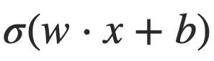
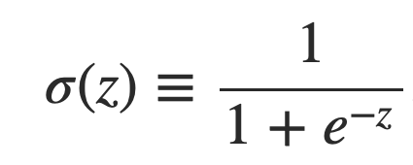
Sigmoid neurons
Problem: a small change in the weights or bias of any single perceptron in the network can causes the output to completely flip from 0 to 1.
Solution: sigmoid neuron
Perceptron
Sigmoid neuron
output =
Output is no longer just 1 or 0.
Same weights and bias as perceptron
Sigmoid function:
Inputs: any real-valued number
Notes:
That flip may then cause the behavior of the whole network to change in a very complicated way.

Slide 30
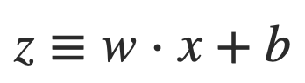
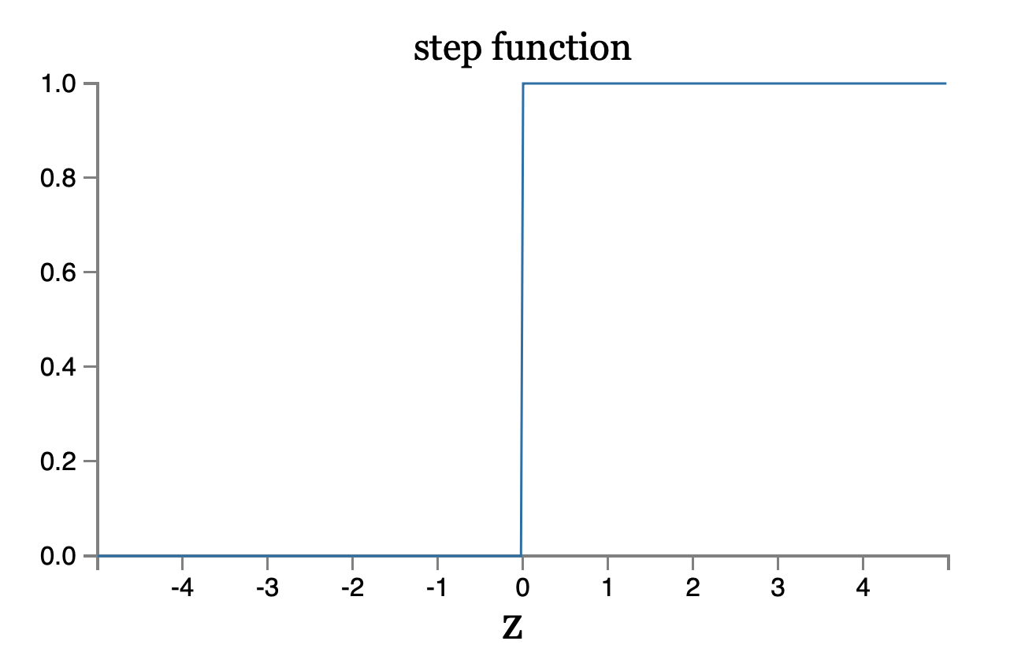
Perceptron

Slide 31
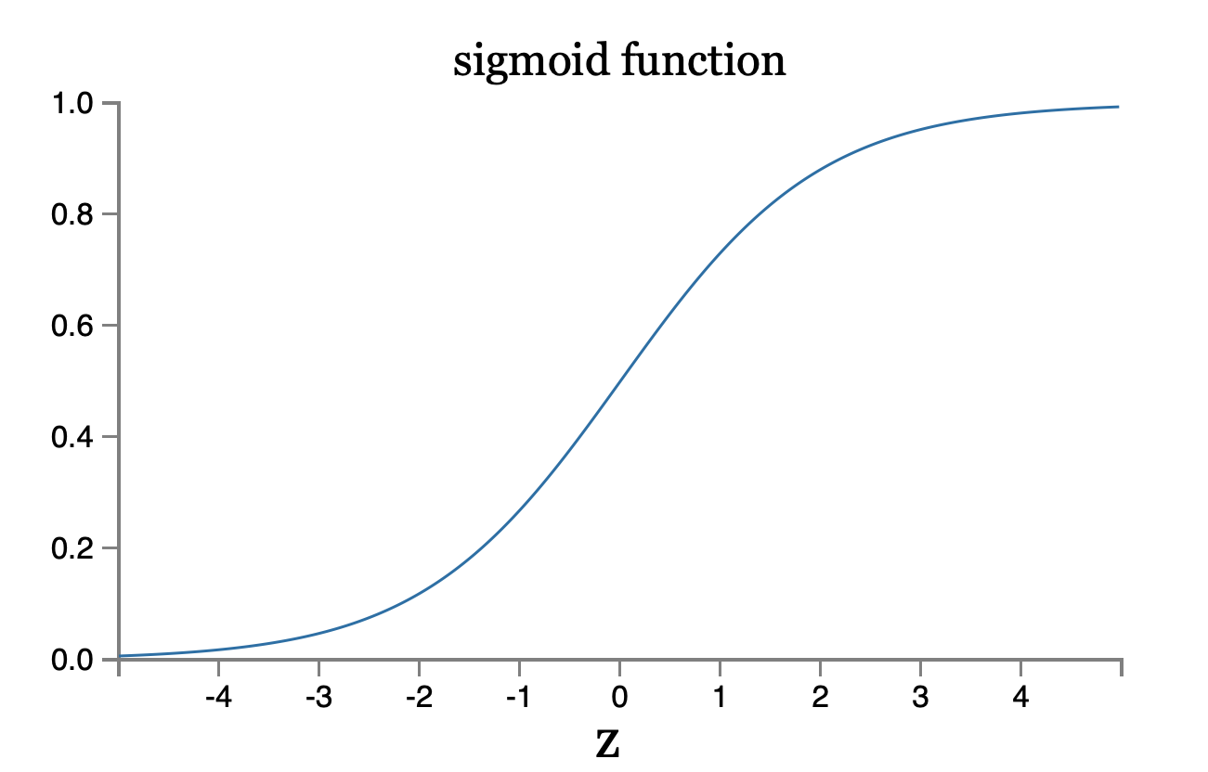
Sigmoid neuron
Notes:
To understand the similarity to the perceptron model, suppose z≡w⋅x+bz≡w⋅x+b is a large positive number. Then e^−z≈00 and so σ(z)≈1. In other words, when z=w⋅x+b is large and positive, the output from the sigmoid neuron is approximately 1, just as it would have been for a perceptron. Suppose on the other hand that z=w⋅x+b is very negative. Then e^−z→∞, and σ(z)≈00. So when z=w⋅x+b is very negative, the behavior of a sigmoid neuron also closely approximates a perceptron. It's only when w⋅x+b is of modest size that there's much deviation from the perceptron model.

Slide 32
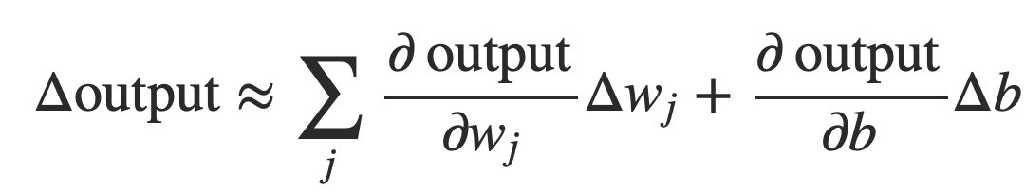
Smoothness is crucial
Smoothness of σ means that small changes in the weights w_{j} and in the bias b will produce a small change the output from the neuron
Δoutput is a linear function of the changes Δwj and Δb
This makes it easy to choose small changes in the weights and biases to achieve any desired small change in the output
Notes:
where the sum is over all the weights, wj and bias b and ∂output/∂wj is the partial derivative of the output with respect to wj. And ∂output/∂b denote partial derivative of the output with respect b.
This linearity makes it easy to choose small changes in the weights and biases to achieve any desired small change in the output. So while sigmoid neurons have much of the same qualitative behaviour as perceptrons, they make it much easier to figure out how changing the weights and biases will change the output.

